Slide 2

Data Binding
A simple way to interact with data
Bounding between UI Elements and Data Objects
Minimal amount of logic

Slide 3
Showcase

Slide 4
Data Context and Binding
class Employee
{
public string EmployeeName { get; set; }
public string EmployeeTitle { get; set; }
public Employee(string name, string title) { … }
}
// page.xaml.cs
Employee employee = new Employee("Nikola Metulev", "Developer Evangelist");
this.MyStackPanel.DataContext = employee;
<!-- page.xaml -->
<StackPanel x:Name="MyStackPanel">
<TextBlock Text="{Binding EmployeeName}" />
<TextBlock Text="{Binding EmployeeTitle}" />
</StackPanel>

Slide 5
Demo

Slide 6



Binding Mode
One Time
One Way
Two Way

Slide 7
INotifyPropertyChanged
using System.ComponentModel;
class Employee : INotifyPropertyChanged
{
//…
public event PropertyChangedEventHandler PropertyChanged;
private void OnPropertyChanged(string property)
{
if (PropertyChanged != null)
{
PropertyChanged(this, new PropertyChangedEventArgs(property));
}
}
//…
}

Slide 8
OnPropertyChanged
class Employee : INotifyPropertyChanged
{
//…
private string name;
public string Name;
{
get { return name; }
set
{
name = value;
OnPropertyChanged(“Name”);
}
}
//…
}

Slide 9
Demo

Slide 10
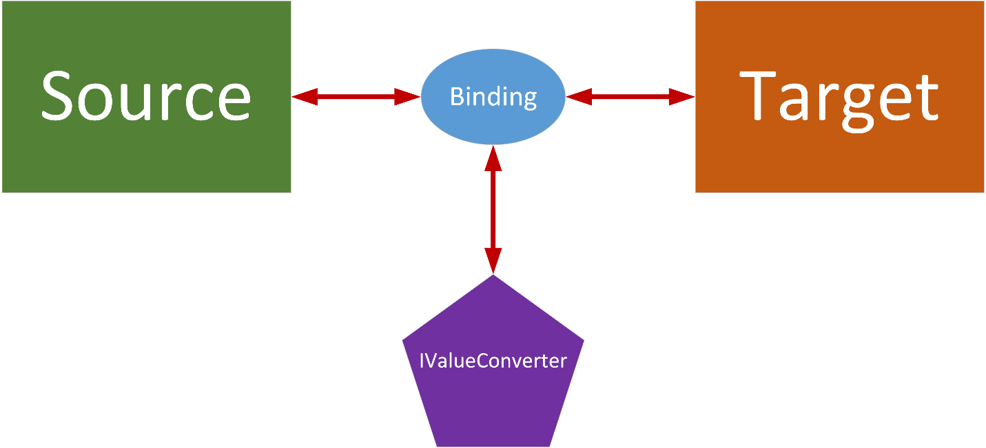
IValueConverter

Slide 11
IValueConverter
using Windows.UI.Xaml.Data;
class MyConverter : IValueConverter
{
public object Convert(object value, Type targetType, object parameter, string language)
{
}
public object ConvertBack(object value, Type targetType, object parameter, string language)
{
}
}

Slide 12
Using MyConverter
<!-- In page.xaml -->
<Page.Resources>
<!-- … -->
<local:MyConverter x:Key=“myConverter" />
<!-- … -->
</Page.Resources>
<!-- … -->
<TextBlock Text=“{Binding Name, Converter={StaticResource myConverter}}” />
<!-- … -->

Slide 13
Demo

Slide 14
ObservableCollection<>
Implements INotifyPropertyChanged and INotifyCollectionChanged
<!-- ListView in page.xaml -->
<ListView x:Name=“MyListView” />
// binding itemsSource of a control to OC in page.xaml.cs
using System.Collections.ObjectModel;
ObservableCollection<Employee> myOC = new ObservableCollection<Employee>();
myOC.Add(new Employee("Kelly Ress", "Hobo”));
myOC.Add(new Employee("Julio Reinoso", "Swishy Hairdresser”));
myOC.Add(new Employee("Darcy Gammel", "Pickpocket"));
this.MyListView.ItemsSource = myOC;

Slide 15
Demo

Slide 16
DataTemplate
<!-- Template for each Item in the Collection -->
<DataTemplate>
<StackPanel Margin="10">
<TextBlock Text="{Binding EmployeeName}" />
<TextBlock Text=“{Binding EmployeeTitle}” />
</StackPanel>
</DataTemplate>

Slide 17
Demo

Slide 18
Binding to Other XAML Elements
<Grid DataContext="{Binding SelectedItem, ElementName=MyListView}“ />

Slide 19
Demo

Slide 20

Thank you
Nikola Metulev
Developer Evangelist
nikolame@microsoft.com
@metulev
These slides and finished code can be found on my blog @ http://blogs.msdn.com/b/metulev/

